Slide 1
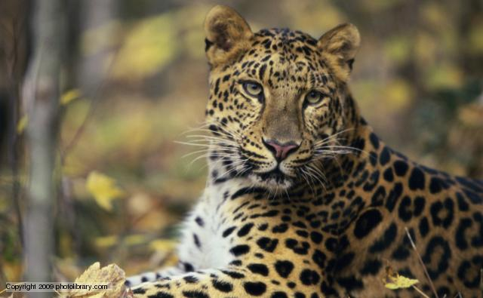
Leopard News
2017-2018 School Year
Nov 27 – Dec 1

Slide 2

Sports- Basketball
Lady Leopards play against Live Oak Ridge MS Wednesday, Nov 29th
7th grade Home and 8th grade away
Games start at 5:30pm and tickets are $2

Slide 3
Sports- Basketball
Leopards play against Live Oak Ridge MS Thursday, Nov 30th
8th grade Home and 7th grade away
Games start at 5:30pm and tickets are $2

Slide 4
Coding Club:
There will be a coding club meeting this Thursday, Nov 30th starting at 3:15pm in room 501.

Slide 5
Rubik’s Cube Wannabe’s:
During the month of November, Mrs. Cox will be hosting a get together to work on how to solve the Rubik’s Cube.
During 7th grade lunch, grab your lunch and go to room 618
Tournament will be held at the end of the month.

Slide 6
Chess Club:
If you are interested in playing chess, the meetings will be Mondays and Fridays from 3:05 to 4pm.
If you have any questions, please see Mr. Cranford in room 713

Slide 7
Student Council:
Interested in an opportunity to develop leadership qualities by organizing and carrying out school activities and service projects?
Student council maybe the right club for you!
see Ms. Brown or Mr. Fulcher

Slide 8
Theatre Club:
Do you love to perform?
Maybe you want to learn?
Come join the Leopards Theatre Club, if you have questions, please see Mr. Glynn in room 706

Slide 9
Photography Club:
Want to learn and try different techniques?
Want to share photos?
Hang out with other photography lovers, on Fridays from 3:10 to 3:55pm in room 408
See Mrs. Stack for more information.

Slide 10
Upcoming Events:
KISD Middle School Parent Night is Tuesday, Nov 28th at Ellison High School starting at 6pm
There are 3 weeks left for this marking period, please make sure that you are keeping up with your grades. There is still time to bring them up if needed.

Slide 11
Upcoming Events:
Please come and support the Smith Middle School Showstoppers at Freddy’s in Killeen off of Clear Creek
Thursday, Dec 7th from 5pm to 8pm.
Hope to see you there!

Slide 12
IDs:
Students your ID must be worn around your neck with the appropriate colored lanyard.
  6th grade- Yellow
  7th grade- Red
  8th grade- Green
If you lose your ID you can purchase a replacement for $5.

Slide 13
Announcements-
Students remember to wear your IDs and make sure that they are out and visible at all times.
Students remember that backpacks are not allowed in the classrooms.

Slide 14
Announcements-
Students check the lost and found located on the ramp to the stage.

